Slide 1
Decorator Design Pattern
Software Design Architecture Lab#7 Saniya Sarim

Slide 2
Decorator Design Pattern
Decorator is a Structural design pattern lets you attach new behaviors to objects by placing these objects inside special wrapper objects that contain the behaviors.
Also known as WRAPPER because it wraps the basic functionality and add more responsibility runtime.
Decorator Design pattern is used to modify the functionality of an object at runtime. At the same time other instances of the same class will not be affected by this, so individual object gets the modified behavior.

Slide 3
Why Decorator Design Pattern
Add additional functionalities/responsibilities dynamically
Remove functionalities/responsibilities dynamically
Avoid too much of sub-classing to add additional responsibilities.

Slide 4
When to Use this pattern?
1. When we want to add additional functionality to the system or the class or the library.
SCENERIO
1. Imagine that you’re working on a notification library which lets other programs notify their users about important events. The initial version of the library was based on the Notifier class that had only a few fields, a constructor and a single send method. The method could accept a message argument from a client and send the message to a list of emails that were passed to the notifier via its constructor.

Slide 5
When to Use this pattern?
At some point, you realize that users of the library expect more than just email notifications. Many of them would like to receive an SMS about critical issues. Others would like to be notified on Facebook and, of course, the corporate users would love to get Slack notifications.

Slide 6
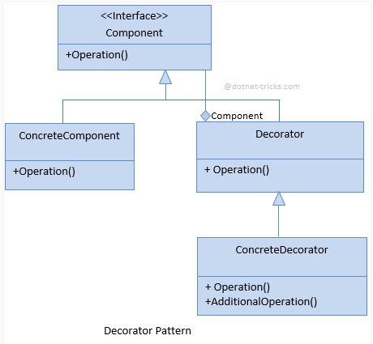
UML Diagram

Slide 7
Implementation Steps
Following are the steps for implementing Decorator design pattern.
Component
This is an interface containing members that will be implemented by ConcreteClass and
Decorator.
ConcreteComponent
This is a class which implements the Component interface.
Decorator
This is an abstract class which implements the Component interface and contains the
reference to a Component instance. This class also acts as base class for all decorators for components.
ConcreteDecorator
This is a class which inherits from Decorator class and provides a decorator for
components.

Slide 8
Example Step by Step

Slide 9
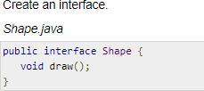
Step1

Slide 10
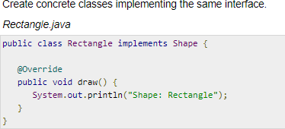
Step2

Slide 11
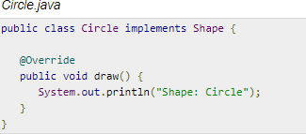
Step2

Slide 12
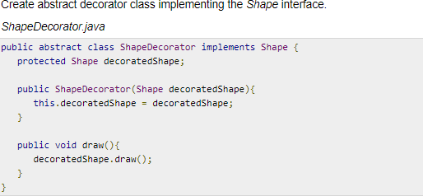
Step 3

Slide 13
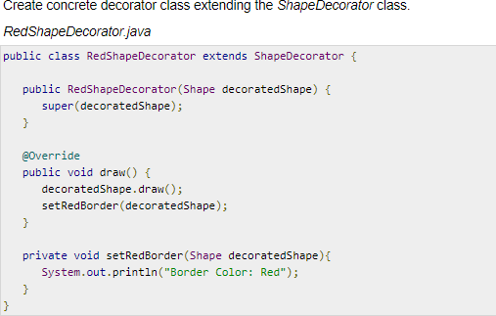
Step 4

Slide 14
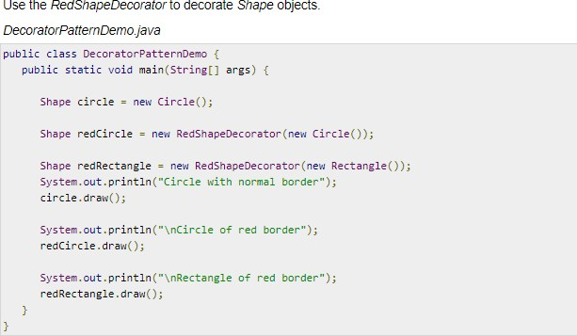
Consumation

Slide 15
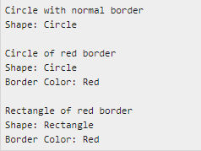
Output

Slide 16
Tasks
1. You are working on an application that have utility to turn flashlight of smartphone On/Off and have a requirement to add ringtones and effects for flashlight in an application, Implement Decorator pattern for adding ringtone functionality in an application that have a basic functionality of flashlight only. decorate an application with ringtones and flashlight effects using Decorator.

